Slide 1




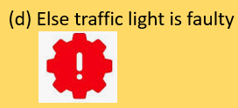
STARTER
What should a driver do when the light is…
RED
AMBER
GREEN
What if the light shows none of these colours?

Slide 2
Topic: Python decisions- if, elif and else
A program checks a condition and chooses what to do.
By the end of the lesson
1. Follow a decision in a flowchart.
2. Predict which message a program prints.
3. Write and test an if / elif / else program.

Slide 3
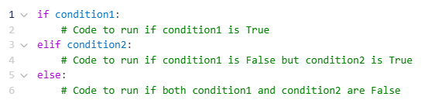
One decision, several possible outcomes
if checks the first condition.
elif checks another condition if the earlier one is False.
else runs if every condition is False.
The first True condition chooses the branch.

Slide 4
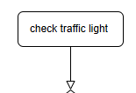
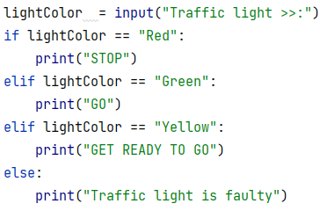
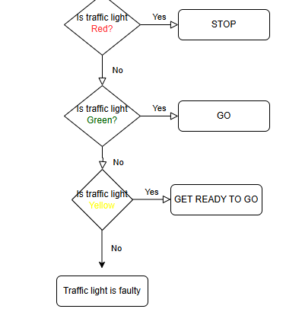
Traffic light: flowchart and Python
Follow the checks from top to bottom.

Slide 5
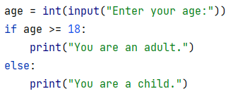


Predict the output: age
Work with a partner. Predict the output for age 43 and age 8.
Then run the code to check.
Why does only one message print?

Slide 6
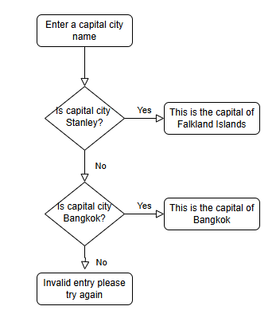
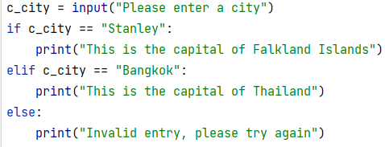
From Python to a flowchart
Draw the flowchart before revealing the answer.

Slide 7

Practice 1: the drinks menu
TEA
COFFEE
"Here is your tea."
"Here is your coffee."
Ask the user to enter tea or coffee.
Choose the correct message using if, elif and else.
Anything else: "Sorry, we only have tea or coffee."

Slide 8
A helpful starting point
drink = input("Tea or coffee? ")
if drink == "tea":
print("________________")
elif drink == "coffee":
print("________________")
else:
print("________________")
Use four spaces before each print statement.

Slide 9
Drinks menu: a worked answer
drink = input("Tea or coffee? ")
if drink == "tea":
print("Here is your tea.")
elif drink == "coffee":
print("Here is your coffee.")
else:
print("Sorry, we only have tea or coffee.")
Test with: tea, coffee and water

Slide 10
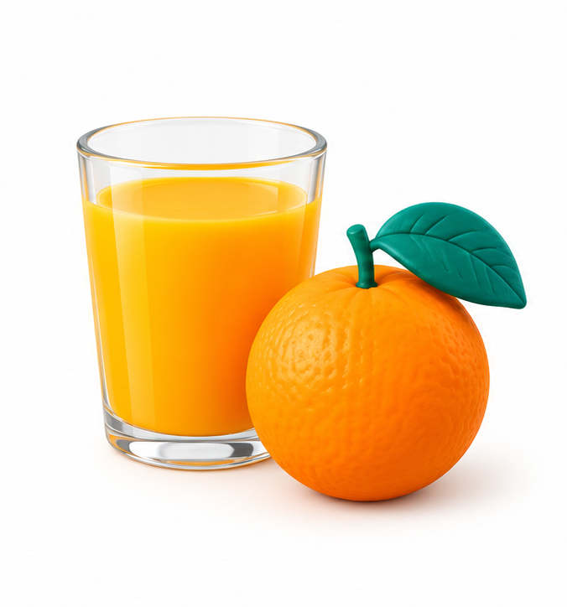
Practice 2: a third choice
JUICE
Add juice to your menu.
For juice, print:
"A healthy choice! Here is your juice."
Update the final message to include all three drinks.

Slide 11
Three drinks: a worked answer
drink = input("Tea, coffee or juice? ")
if drink == "tea":
print("Here is your tea.")
elif drink == "coffee":
print("Here is your coffee.")
elif drink == "juice":
print("A healthy choice! Here is your juice.")
else:
print("We only have tea, coffee and juice.")
The extra elif comes before else.

Slide 12
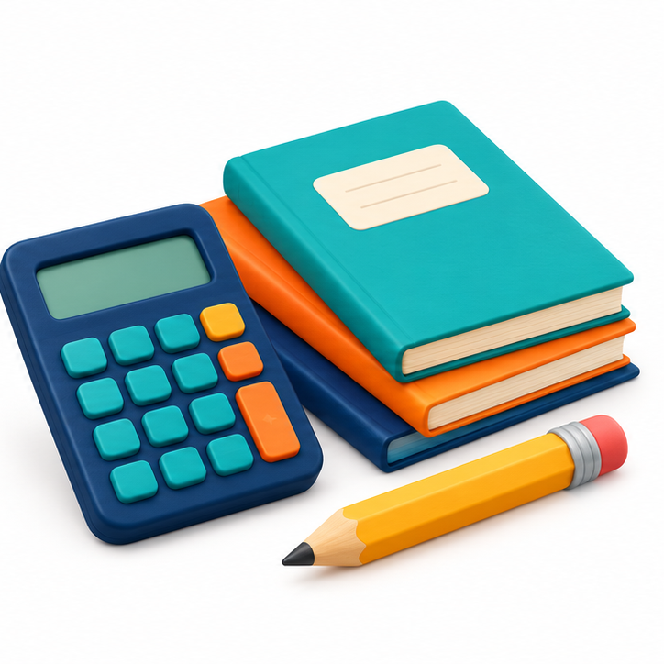
Practice 3: a grade calculator
Ask for three scores from 0 to 100.
Calculate the average and display its grade.
Average
Grade
80 or more
70 to less than 80
60 to less than 70
50 to less than 60
Below 50
A
B
C
D
F

Slide 13
The average: a worked answer
score1 = float(input("Score 1: "))
score2 = float(input("Score 2: "))
score3 = float(input("Score 3: "))
average = (score1 + score2 + score3) / 3
print("Average:", average)
Example: 80, 70 and 90 give an average of 80.

Slide 14
Choosing the grade
if average >= 80:
print("Grade: A")
elif average >= 70:
print("Grade: B")
elif average >= 60:
print("Grade: C")
elif average >= 50:
print("Grade: D")
else:
print("Grade: F")
Check the highest
score first.
If the first check is False,
the average is
already below 80.

Slide 15
Tracing a decision: average = 75
Check
Result
75 >= 80
False: try the next condition
75 >= 70
True: print Grade: B
The remaining branches are skipped.

Slide 16
Why the order matters
average = 85
if average >= 50:
print("Grade: D")
elif average >= 80:
print("Grade: A")
85 >= 50 is True.
The program prints D
and skips the elif.
How would you fix the order?

Slide 17
Spot the errors
drink = input("Tea or coffee? ")
if drink = "tea"
print("Here is your tea.")
else drink == "coffee":
print("Here is your coffee.")
Find four errors. Then rewrite the program.
Think about comparison, colons, indentation and elif.

Slide 18
Debugging: the corrected code
drink = input("Tea or coffee? ")
if drink == "tea":
print("Here is your tea.")
elif drink == "coffee":
print("Here is your coffee.")
else:
print("Sorry, we only have tea or coffee.")
== compares values. A colon starts each branch.
Indent each branch. Use elif for another condition.

Slide 19
Separate if statements or one chain?
Separate if statements
One if / elif chain
score = 85
if score >= 50:
print("Pass")
if score >= 80:
print("Excellent")
score = 85
if score >= 80:
print("Excellent")
elif score >= 50:
print("Pass")
Both messages print.
Each if checks separately.
Only Excellent prints.
The chain chooses one branch.

Slide 20
Quick check
1. Which keyword checks another condition?
2. When does else run?
3. What grade does an average of 70 receive?
4. Why must the statements inside a branch be indented?

Slide 21
Quick check: answers
1. elif
2. When every earlier condition is False.
3. Grade B.
4. Indentation shows which statements belong
to that branch.

